Slide 1
Unsupervised Learning with NLP to Extract Similarities between Terms of Services
Preliminary Results
Andrew Haverly

Slide 2
Research Hypotheses
A clustering algorithm can be used to identify which known ToS is most similar to an unknown ToS.
A vector similarity measure can be used to compare the similarity of one ToS to another ToS.
A hierarchical clustering algorithm can be used to visually examine the similarity between many ToS.

Slide 3
A clustering algorithm can be used to identify which known ToS is most similar to an unknown ToS.
Plan:
Create TF-IDF feature vectors using many ToS.
Determine which ToS are known to the user.
Create as many clusters as there are ToS using a clustering algorithm.
Use the clustering algorithm to predict which known ToS is most similar to an unknown ToS.

Slide 4
A clustering algorithm can be used to identify which known ToS is most similar to an unknown ToS.
Known ToS: Zoom, Apple Media Services, Microsoft, Twitter, Snapchat, TikTok, Google Terms, Google Privacy Policy, Facebook
Unknown ToS: Pandora
K-Means Prediction on Similarity: Zoom

Slide 5
A vector similarity measure can be used to compare the similarity of one ToS to another ToS.
Plan:
Use the same TF-IDF feature vectors as before.
Determine which ToS are known to the user.
Compare the unknown ToS to all of the known ToS.
Rank the known ToS from most similar to least similar.

Slide 6
A vector similarity measure can be used to compare the similarity of one ToS to another ToS.
ToS | Cosine Similarity (to Pandora) | Euclidean Distance (to Pandora)
Zoom | 0.9729202705615457 | 0.23272184873128812
Apple Media Services | 0.9118911184054235 | 0.41978299535492514
Snapchat | 0.892402975660453 | 0.46389012565379517
Twitter | 0.8774881859662943 | 0.4949986142075663
Microsoft | 0.8469773144514582 | 0.5532136758044607
TikTok | 0.8150336854204963 | 0.6082208720185516
Facebook | 0.48663980566447396 | 1.0132721197541417
Google Terms of Service | 0.378800152777456 | 1.1146298463817879
Google Privacy Policy | 0.2901009383527129 | 1.1915528201865722

Slide 7
A hierarchical clustering algorithm can be used to visually examine the similarity between many ToS.
Plan:
Use the same TF-IDF feature vectors as before.
Use a hierarchical clustering algorithm (Agglomerative Clustering).
Recursively merges the pair of clusters that minimally increases a given linkage distance, using the Euclidean distance [1].
Plot the hierarchical clusters in a dendrogram.
Use this clustering algorithm to compare the similarity of known ToS to an unknown ToS.

Slide 8
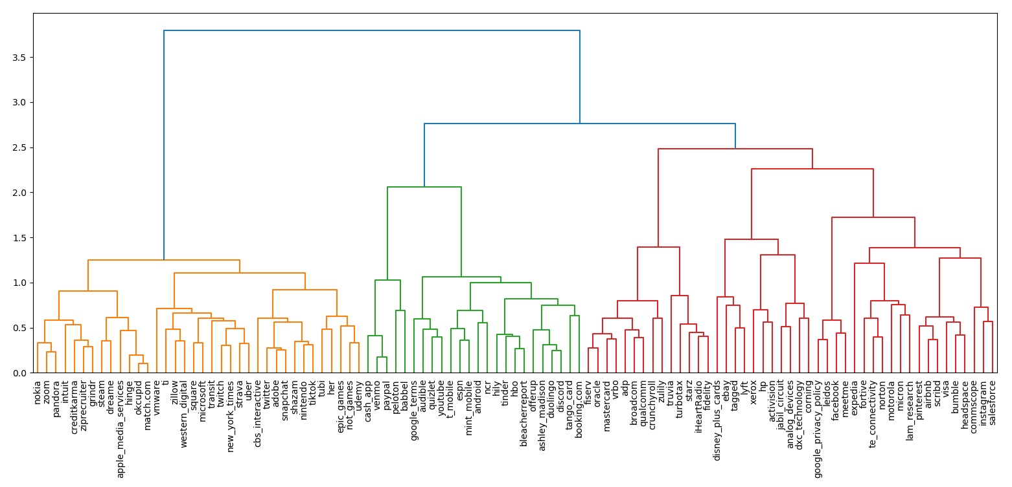
Hierarchical Clustering Output

Slide 9
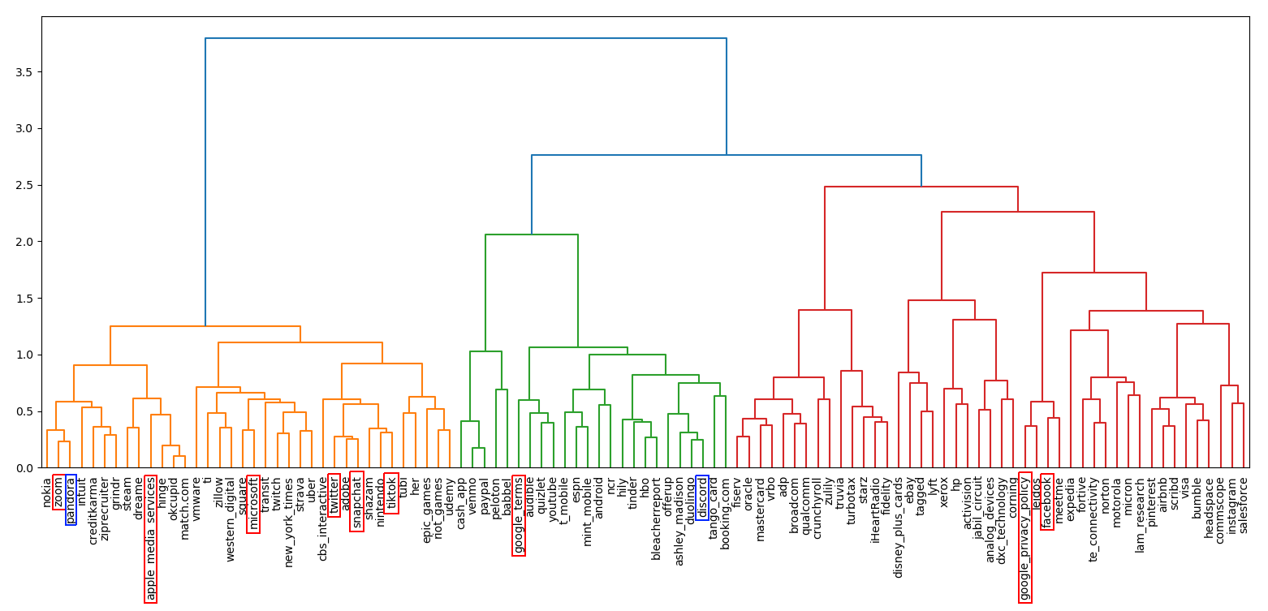
Shaping the Hierarchical Clustering Method to the Hypothesis

Slide 10
Potential Improvements
Find the ideal threshold that can be used to determine whether two ToS can be considered similar.
Be able to create the TF-IDF feature vector of an unknown ToS without including its word frequency in the total document word frequencies.
Find which feature affects similarity the most.
Expand the feature vectors beyond TF-IDF.
Allow the user to select which features are most important (data/privacy, censorship, monetary concerns, etc.)

Slide 11
Works Cited
[1] “Sklearn.cluster.AgglomerativeClustering.” Scikit,
scikit-learn.org/stable/modules/generated/sklearn.cluster.AgglomerativeClustering.html.

Slide 12
Questions?

